Slide 1
Computing as an Interdisciplinary Toolkit
Day 1

Slide 2
Political Science
Linguistics
Art and Music
Cognitive Science
Computation
Neuroscience
Robotics
Biology
Data Mining
Economics
Epidemiology
Physics

Slide 3
Why not just view the world like this???
Political Science
Linguistics
Art and Music
Cognitive Science
Neuroscience
Robotics
Biology
Data Mining
Economics
Epidemiology
Physics

Slide 4
What Makes Computing Such a Potent Skill? Or, How this Class Will Give You Superpowers¹.
If you know how to use professional software engineering tools and processes, you can:
Combine multiple existing software packages to do something awesome
Build your own tool from scratch to solve problems (or help some people) that are important to you
¹ The SoftDes faculty assume no liability if this class does not actually give you superpowers

Slide 5
What Makes Computing Such a Potent Skill? Or, How this Class Will Give You Superpowers¹.
If you know how to frame a problem computationally, you can:
Develop creative solutions to hard problems
See connections between your problem and other problems that initially seemed unrelated
¹ The SoftDes faculty assume no liability if this class does not actually give you superpowers

Slide 6
What Makes Computing Such a Potent Skill? Or, How this Class Will Give You Superpowers¹.
If you know how to effectively communicate and understand computational ideas, you can:
Maximize the impact of code you write
Work effectively (speak the same language) as software developers that you might collaborate with or hire
¹ The SoftDes faculty assume no liability if this class does not actually give you superpowers

Slide 7
Anecdotes from Recent Faculty Search
Computation in Astronomy
Computation in Healthcare
Computation in Social Justice
…

Slide 8

Computer Graphics

Slide 9
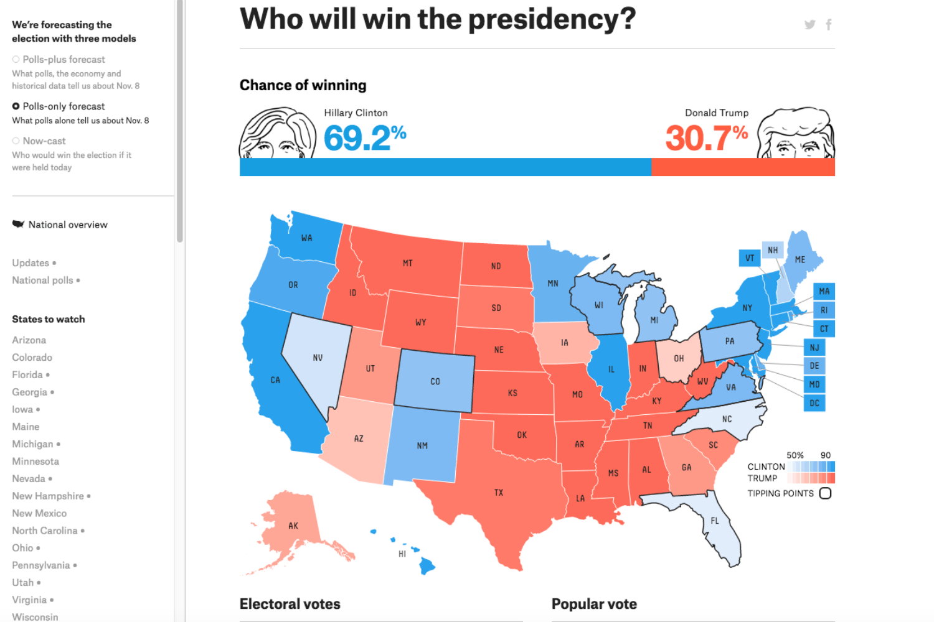
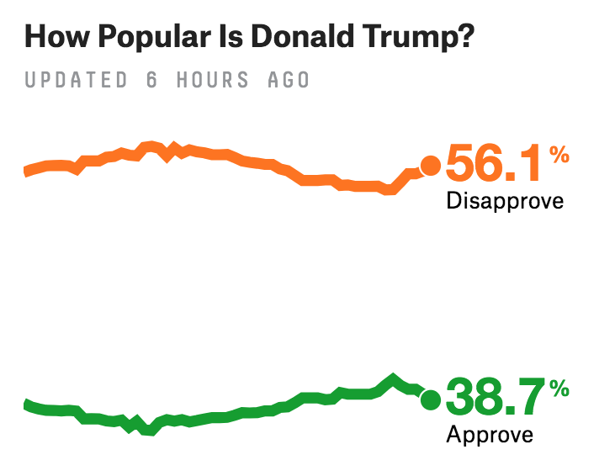
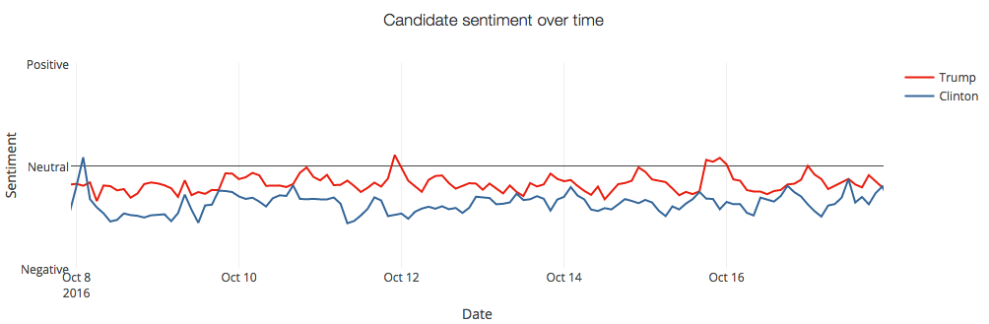
Political Science
Notes:
I just finished a BA with a political science major. I also have one year of a computer science degree. While doing political science, there were many times I wished I was better at programming and able to write programs that could retrieve and analyze data. I used programs for mapping patterns. Again, I wished I could redesign those programs to work better for political science. Then there's algorithms. I wish I was better at discrete mathematics. There are patterns that can be found and predictions that can be made. If you are doing election related analysis there is so much that can be done with computer science. Those polls have a lot of room for improvement. Simulation would provide a lot of insight to visualize events, scenarios, and patterns. Every sub discipline of P.S. has statistical components that could be improved by algorithms and programs. Political science is nothing other than 'information to be processed'

Slide 10
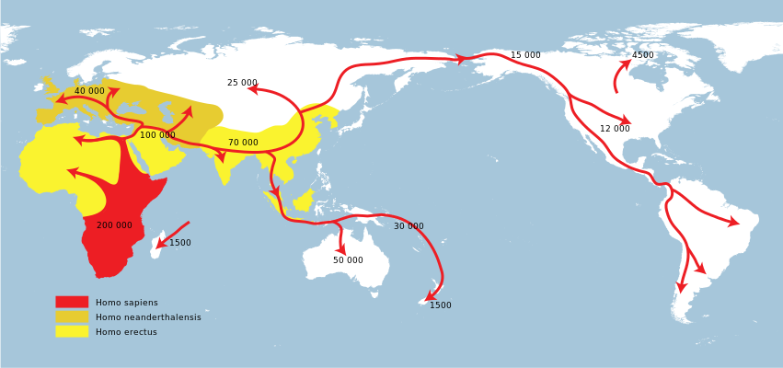
Computational Biology: Origin of Modern Humans
Notes:
Mitochondria are thought to be endosymbionts (an organism living within the body of another organism). Mitochondrial eve was about 190,000 years ago.

Slide 11
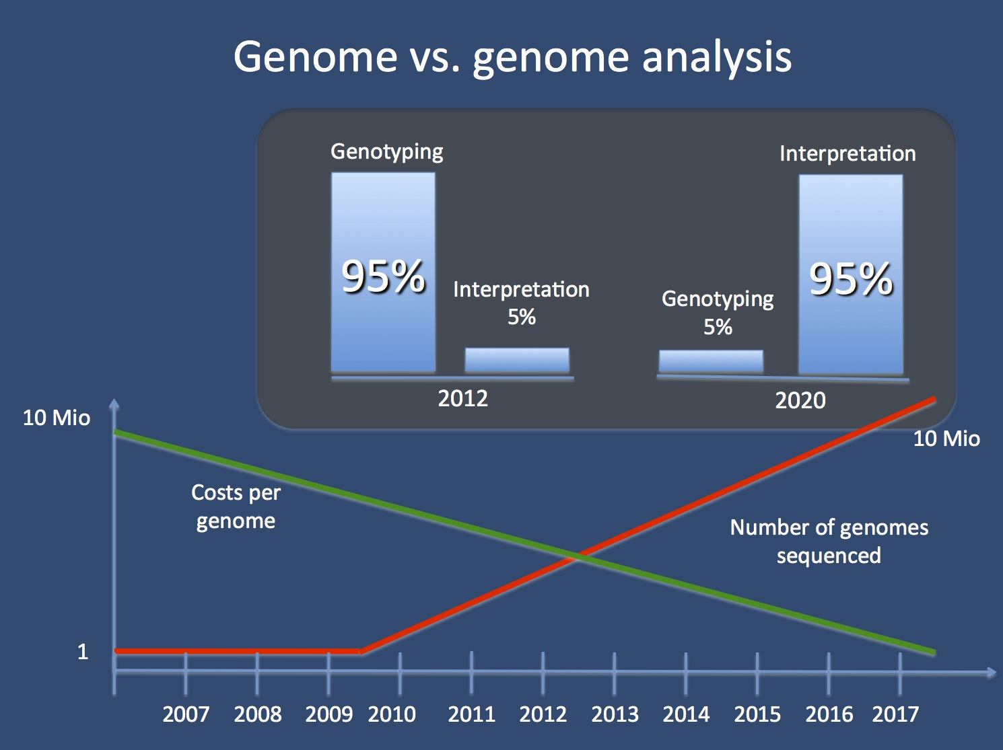
Bioinformatics
Has the potential to lead to better screening and understanding of complex syndromes and diseases.

Slide 12
Medical Imaging
Automated lesion detection
Computer aided diagnosis of CAT scans of the lung
Etc.
http://ieeexplore.ieee.org/document/7463094/#full-text-section

Slide 13
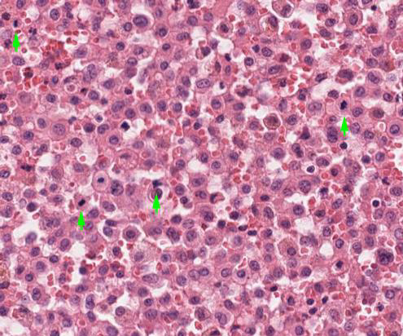
Medical Imaging: Histology

Slide 14
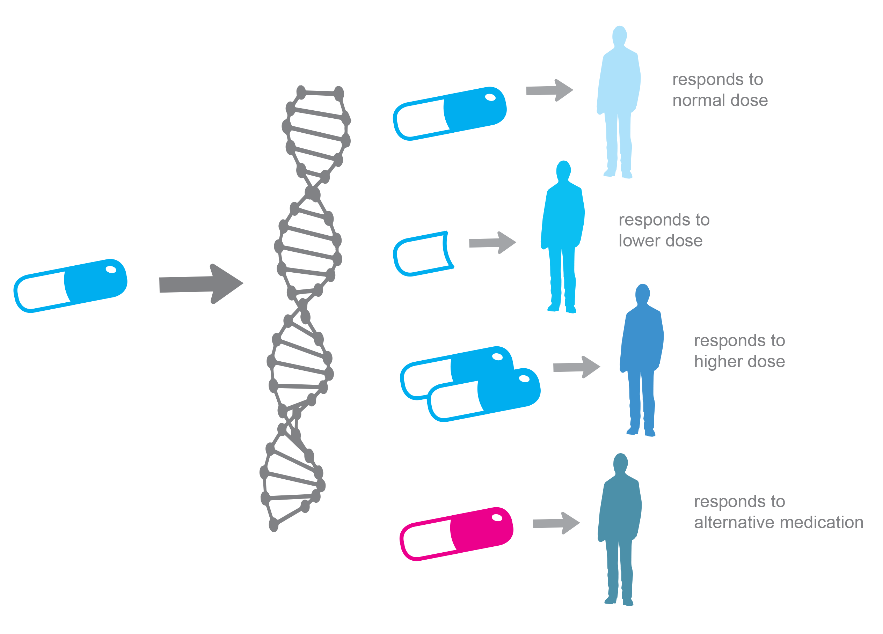
Personalized Medicine

Slide 15
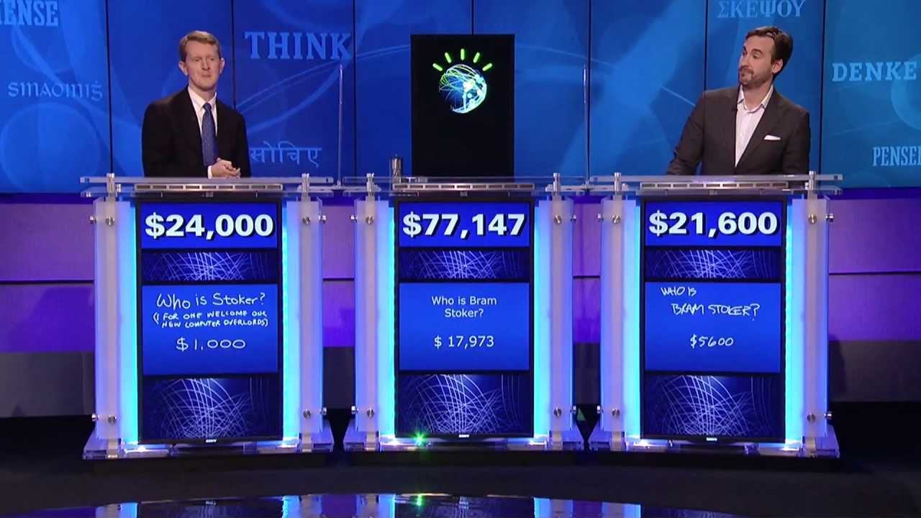
AI / Machine Learning

Slide 16
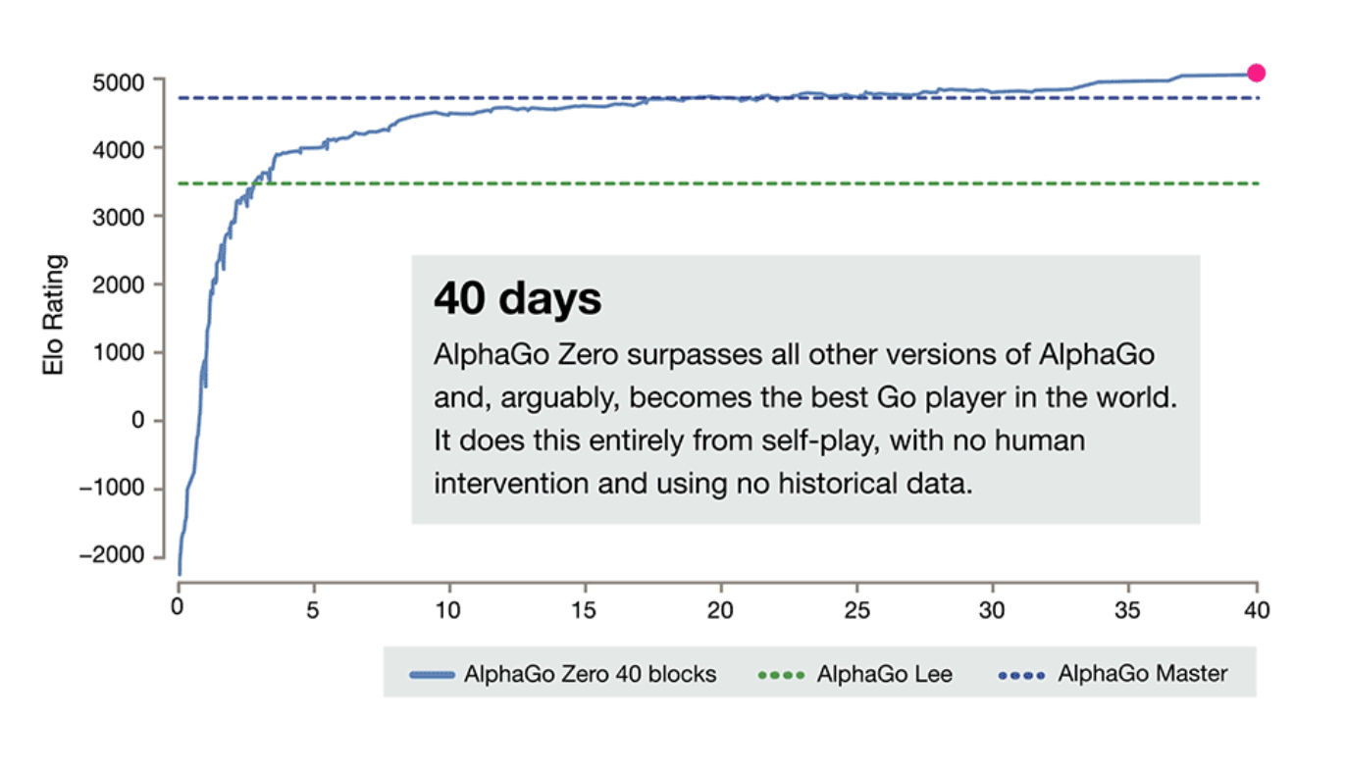
AI / Machine Learning

Slide 17
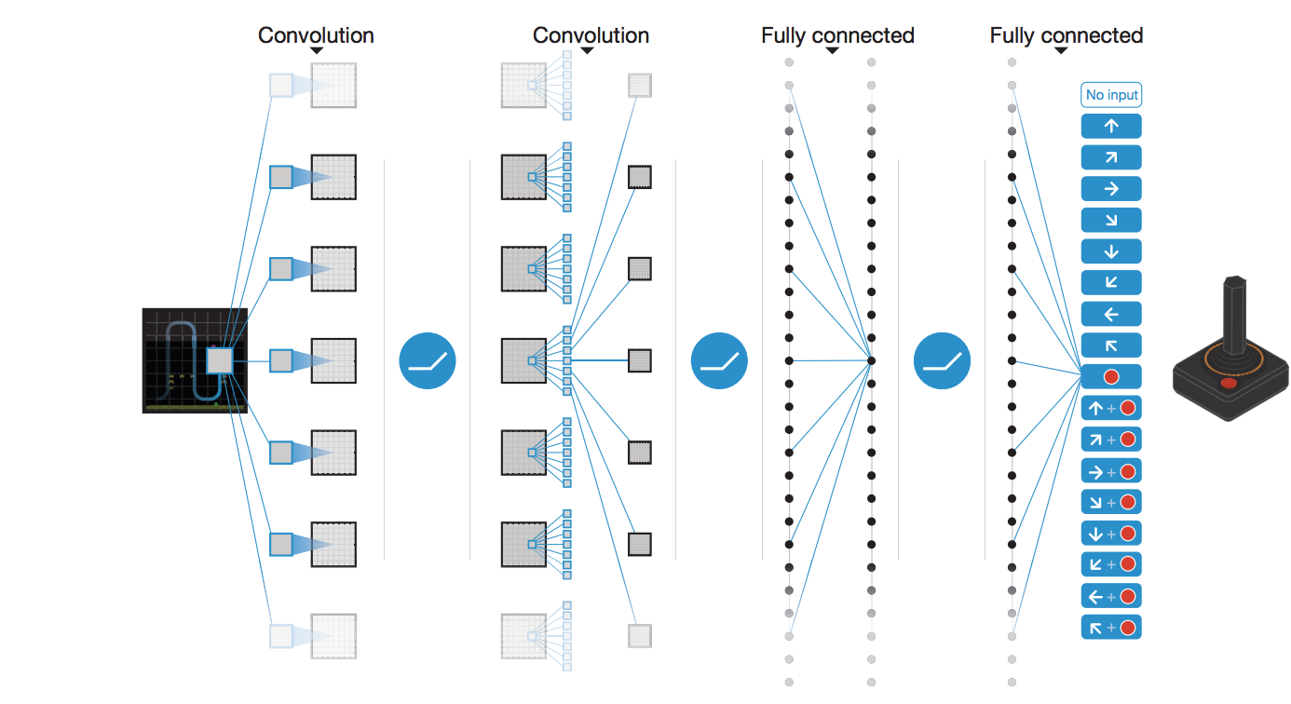
AI / Machine Learning

Slide 18
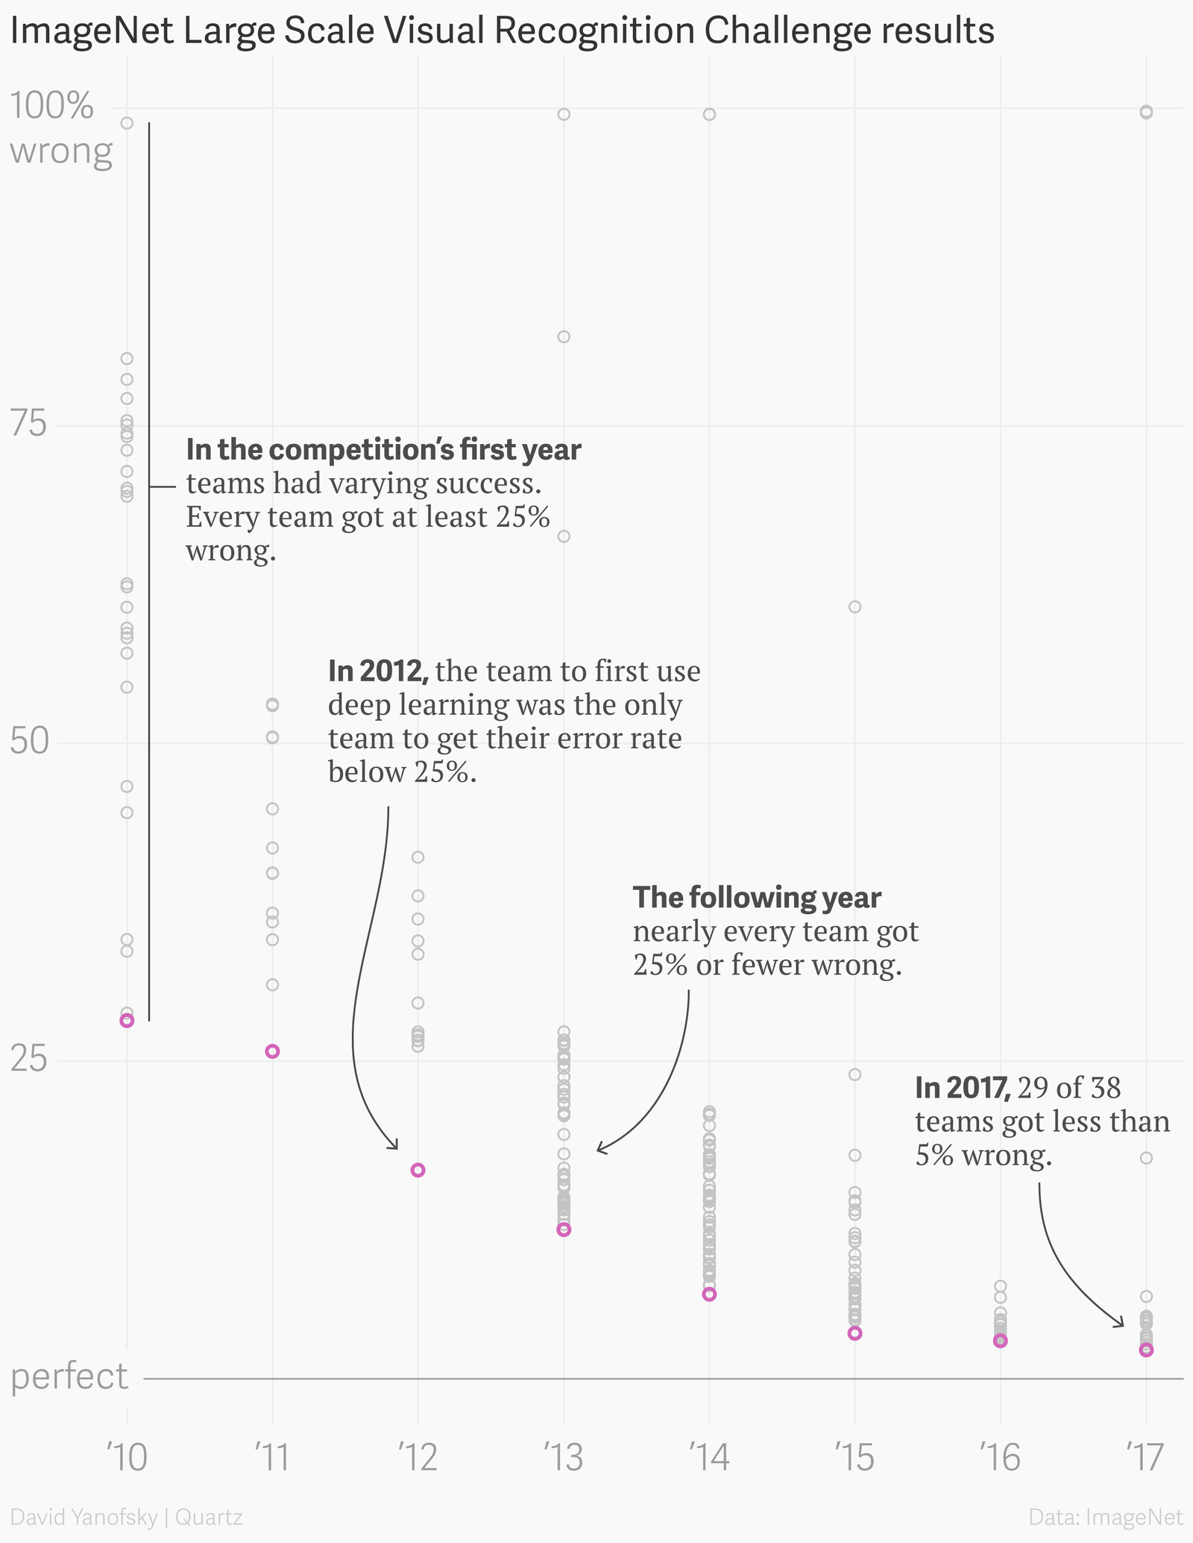
AI / Machine Learning

Slide 19
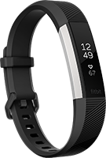

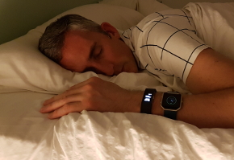
Wearable Sensing

Slide 20
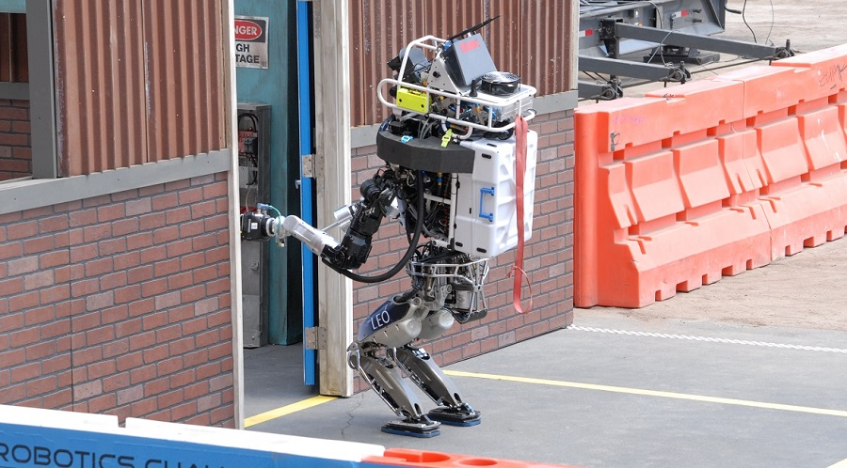
Robotics: DARPA Robotics Challenge

Slide 21

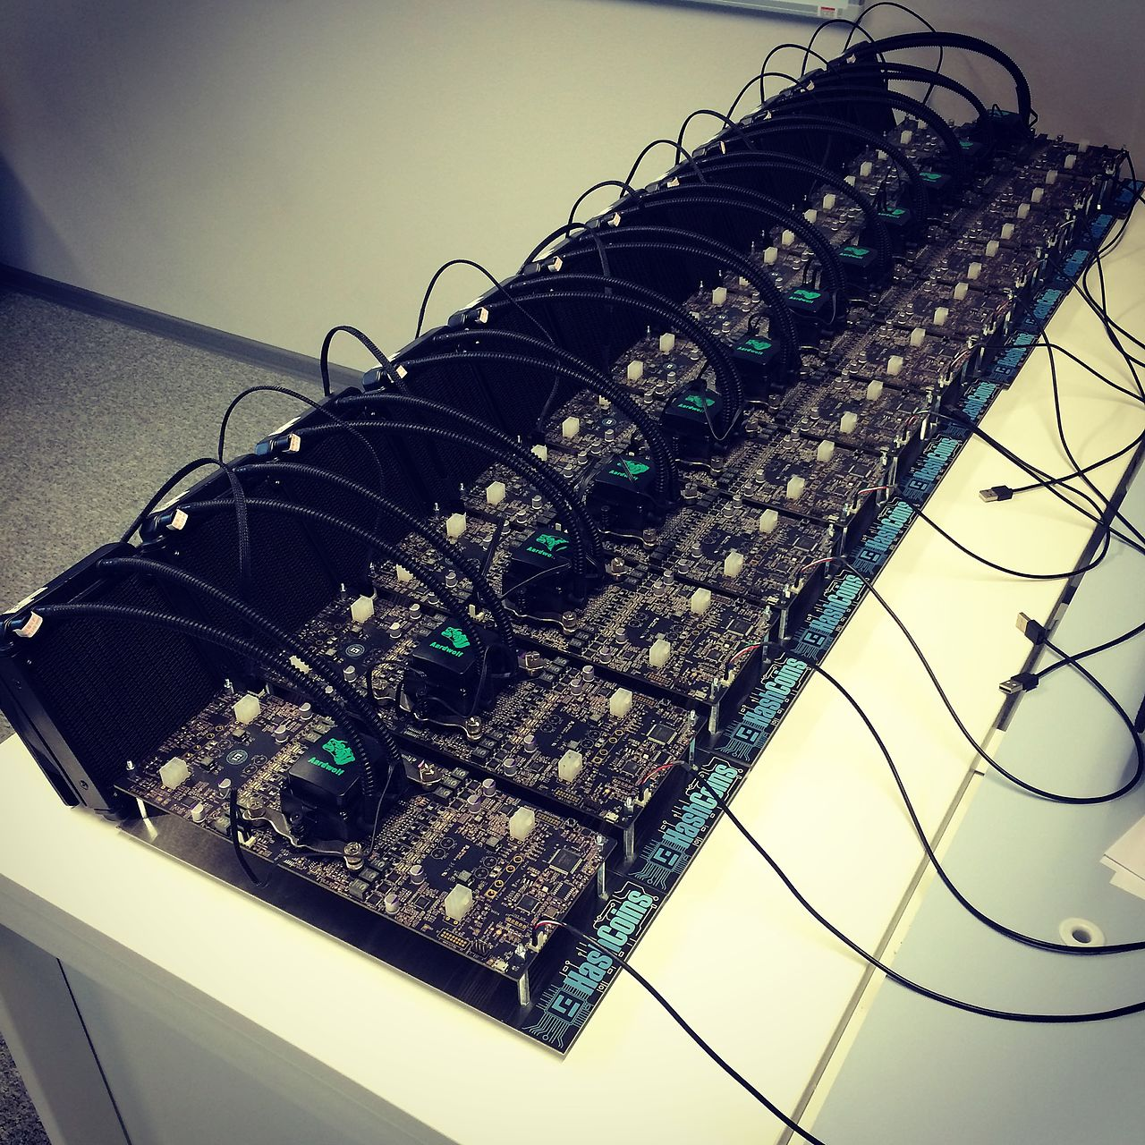

Crypto Currencies
BitCoin mining hardware

Slide 22
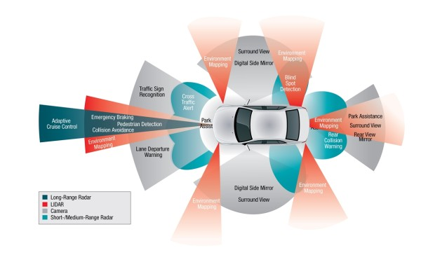
Robotics: Self-driving Cars

Slide 23
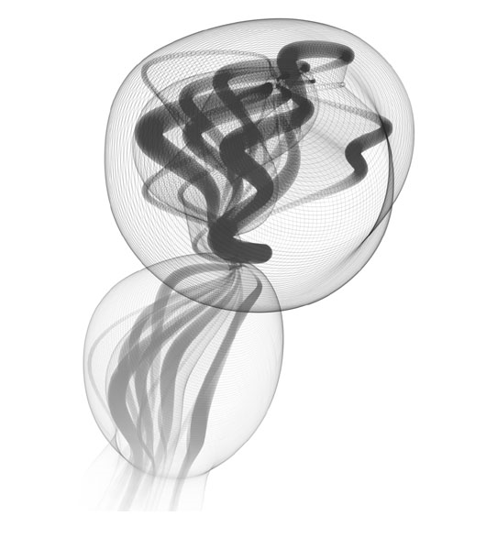
ART and Music
Protobytes
By Ira Greenberg

Slide 24
For Your Processing
http://fyprocessing.tumblr.com/

Slide 25

ART and Music
“The Triumph of the Cyborg Composer”
http://www.psmag.com/mustread/triumph-of-the-cyborg-composer-8507/
Excerpts from Light and Darkness
By Emily Howell

